Slide 1
Fake news detection

Slide 2
AGENDA
Introduction​
Process
​Libraries and Tools used
Expected output
​

Slide 3
PROBLEM STATEMENT
The main objective is to generate a model that can discriminate between “fake” and “true” news articles when it is trained with a certain dataset and send the true news to the user who has posted it.

Slide 4
PROCESS OF DETECTON

Slide 5
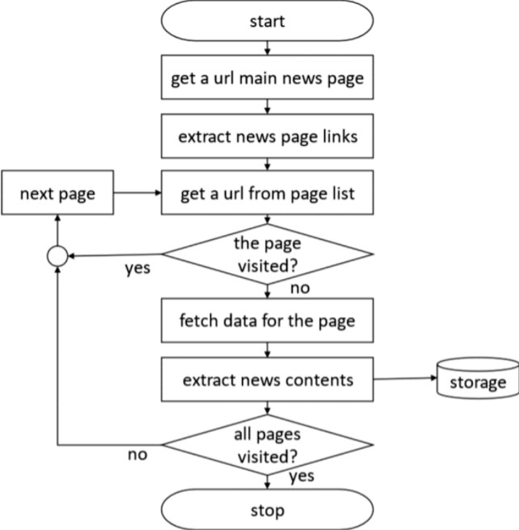
INFORMATION RETRIEVAL
Instead of web crawler we can also use an already prepared dataset which is present in Kaggle.

Slide 6
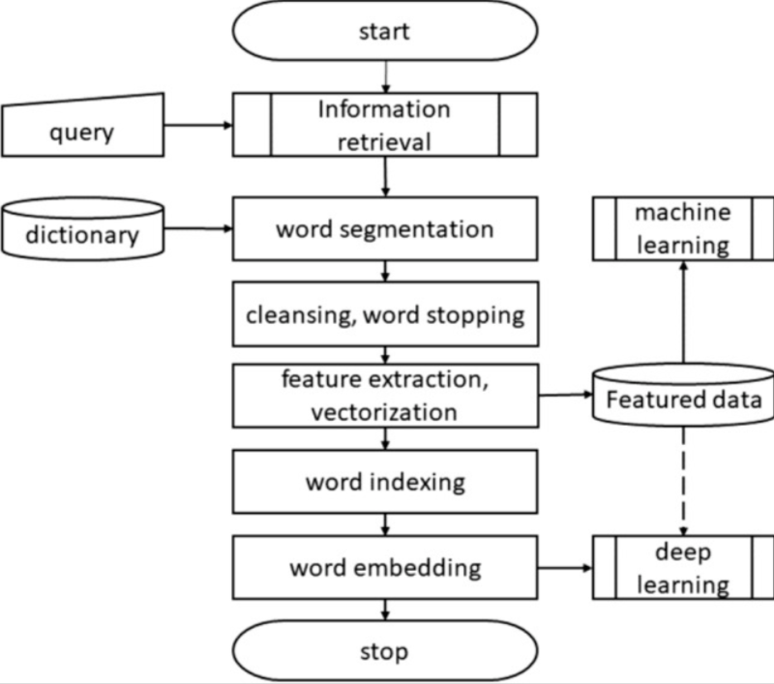
NLP READER

Slide 7
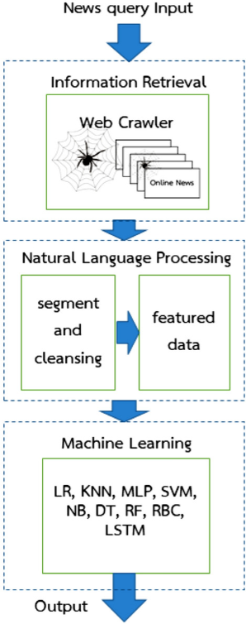
ML ALGORTHIMS

Slide 8
LIBRARIES
NUMPY
PANDAS
SEABORN
SKLEARN
MATPLOTLIB
OS
LANGUAGES
PYTHON:
NLP
ML
WEB DEVELOPMENT
STREAMLIT

Slide 9
EXPECTED OUTPUT
The model must efficiently distinguish between true news and fake news with maximum accuracy.

Slide 10
THANK YOU

